Slide 1
CYBER
FORENSICS
& SECURITY
Investigating Digital Crimes , Protecting Digital Evidence

Slide 2
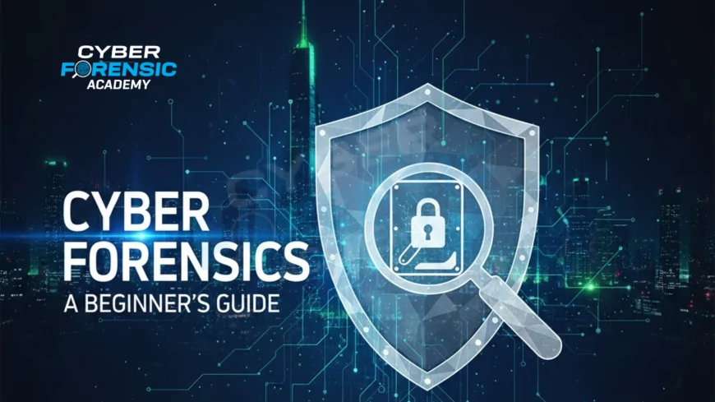

Slide 3
What Is Cyber Forensics ?
Cyber forensics and security is a field of cybersecurity that focuses on protecting digital systems and investigating cybercrimes. Cybersecurity helps prevent threats such as hacking, malware, and data theft, while cyber forensics involves collecting and analyzing digital evidence after a cyber incident. It helps organizations identify attackers, understand how an attack happened, and prevent similar incidents in the future.

Slide 4
Digital Evidences And Its Types
Digital evidence is any information stored or transmitted in digital form that can be used to investigate or prove a cybercrime or other incident. It can be found on computers, mobile phones, networks, cloud storage, and other electronic devices.
Types of Digital Evidence
Computer evidence: Files, documents, system logs, and deleted data from computers.
Mobile evidence: Text messages, call records, photos, videos, and app data from phones.
Network evidence: IP addresses, network logs, emails, and records of online activity.
Internet evidence: Browser history, cookies, downloads, and search history.
Email evidence: Emails, attachments, sender/receiver information, and timestamps.
Cloud evidence: Data stored in services such as cloud drives and online accounts.
Social media evidence: Posts, messages, images, comments, and account activity.

Slide 5
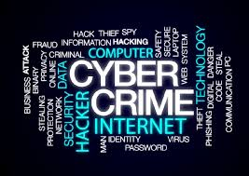
CYBER CRIMES

Slide 6

PHISHING
Phishing is a cyber attack where criminals trick people into revealing sensitive information such as passwords, bank details, or personal data through fake messages or websites.
This Photo by Unknown Author is licensed under CC BY-ND

Slide 7
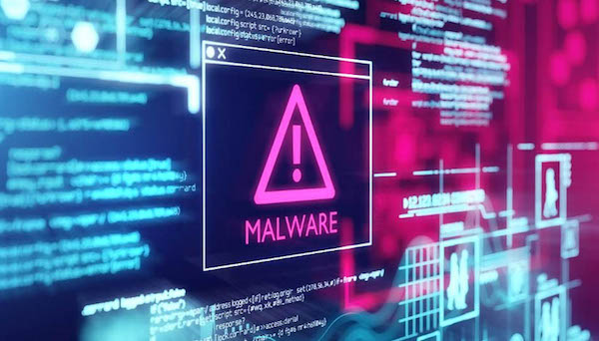
MALWARE
Malware is harmful software created to damage, steal data from, or gain unauthorized access to computer systems.
This Photo by Unknown Author is licensed under CC BY-NC-ND

